Slide 1
deliberate practice for programmers
https://www.codingblocks.net/practice/

Slide 2
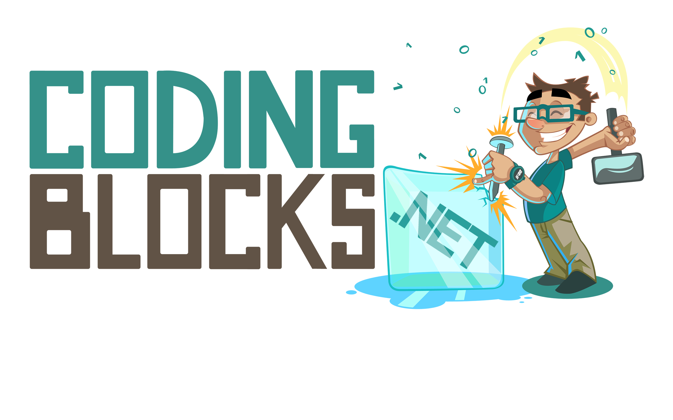
Summary
Skills are important and neglected
Deliberate Practice is the most effective way to advance skills
We can do this!
https://codingblocks.net/practice/
Notes:
Podcast Diversity
We all want to be better
Because of that, I’ve read…
Good news, research!
5 Way Book Report
In this talk…
What it means to be better
Deliberate Practice is the best to develop skills
Apply the best lessons to Software Engineering

Slide 3
Skills are important
…and neglected?
Notes:
What does it mean to be good?
10x Developer
Problems with the study
How did they measure?
Program Size
Time to complete
Debugging Time
What about Jira?
I want to be better at all of that stuff!

Slide 4
Knowledge vs skill
Things you know | Things you can do
Algorithms, Design Patterns, Data Structures | Devise, analyze, implement
How Security Exploit work | Find exploits in the wild
{Language, Framework, Domain} | Make cool stuff
Notes:
What does it mean to be good?
Knowledge is understanding of a subject,
Skill is your proficiency in the application of knowledge.
K is what you know
S is what you can do with it
Algorithms, Design Patterns, Game Programing, Web Design
They want to make stuff!
Knowing is only half the battle!

Slide 6
Dependency injection example
Let’s get SOLID!
Notes:
Read a book on SOLID
Fire up your IDE at work…
Coding is really hard!

Slide 7
Programming is a developed skill
http://abstrusegoose.com/249
Notes:
Describe the comic
Strife in the Industry
10x developer
Interviewing
Bootcamps vs 4 year degrees
Resources for knowledge: Code Camps, Pluralsight, Podcast
What advice for those who want to improve their programming skills?

Slide 8
Side Projects…
“Practice makes permanent”
Specific knowledge, skill, time requirements
Not be time efficient
Short cuts and distractions reinforce bad practices
Focusing on one skill can be detrimental to others
Notes:
Be mindful of downsides
Side projects require knowledge, skill, time
Mixed incentives can reinforce bad habits
Potentially wasting time on things you didn’t intend or need to practice
Need to understand your goals

Slide 9
Scrimmage vs Drills
Scrimmages are great for evaluation, not for practice
Time inefficient
Not focused enough
Think about field goal kickers? Pilots?
https://www.wegotplayers.com/soccer-training-vs-games/
Notes:
Same lessons apply:
Soccer scrimmage: 22:1
10-40 ball touches per game
Soccer 90 minute practice 4:1 Player:Ball ratio…
200-400 ball touches
* It’s not time effective
Mixed motives compete for attention and make assessment difficult
Commercial pilots, more time landing?

Slide 10

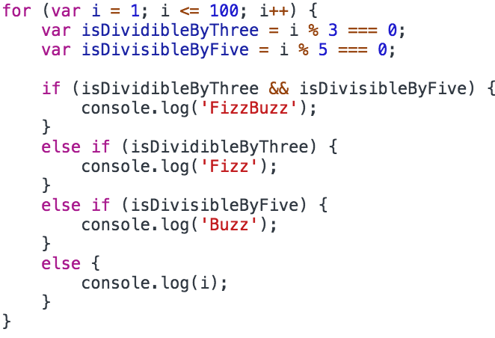

Explicit Procedural
Notes:
FizzBuzz in JS
Too tedious for our brains to operate at this level
Never memorize anything you can look up!
Your brain hates this, it loves short-cuts for both good and bad.
Concept gets converted to an Implicit Declarative – keeps us sane
It can also be wrong: harmful stereotypes and bias
That’s why we spend so much time talking about concepts like abstraction, modularity and code organization

Slide 11

Fizzbuzz
Implicit Declarative instructions operate at a higher level of abstraction. “Chunking”
Notes:
Can’t you flip it on like a switch?
Sure, you could decide line by line, variable by variable – but your brain is desperate to operate at a higher level
It’s constantly trying to kick into auto-pilot
If your not careful, you can end up internalizing those bad habits and slipping into them

Slide 12
https://sciencestruck.com/inventions-of-archimedes
Notes:
Implicit/Declarative tasks free your brain
Solving bugs in the shower
How clean is your code if you’re coding via Stack Overflow?

Slide 13
Is it too late for me?
Recognize the cue
Substitute the good behavior
Treat yo self
Notes:
Ideally we wouldn’t have any bad habits to fix
Back on planet earth….
What is the signal?
What should you do instead?
How can we reward?
PR?
Talk about it?
Get a coffee?

Slide 14
What about natural talent?
Growth vs Fixed Mindset
How close are you to maximizing your potential?
Notes:
The average pro basketball player in the NBA is 6’7”
People who speak tonal languages are more likely to develop perfect “pitch”
Michael Phelps has better lung capacity and produces less lactic acid
However, do you really think that you’ve hit your capacity? Are you anywhere near it?

Slide 15
deliberate practice for programmers
How best to advance your skills
Notes:
So, what should you do if you really want to improve?
Answer is deliberate practice: Deliberate practice is a results driven feedback loop that requires focused attention.
It’s important, because researchers say that deliberate practice is the best way to develop skills.
Playing your favorite song on guitar is not deliberate practice. Recording yourself playing your favorite song, grading yourself on the various skills involved, and then devising, executing, and measuring practices that specifically target those areas over time is deliberate practice
38s

Slide 16
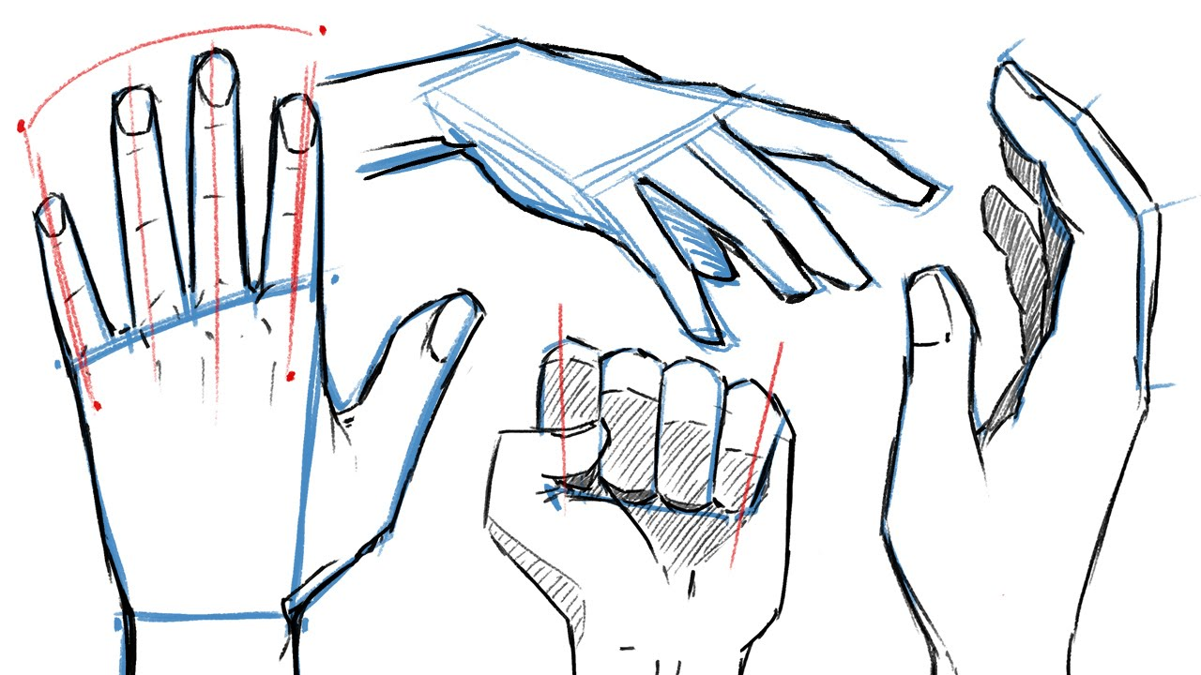
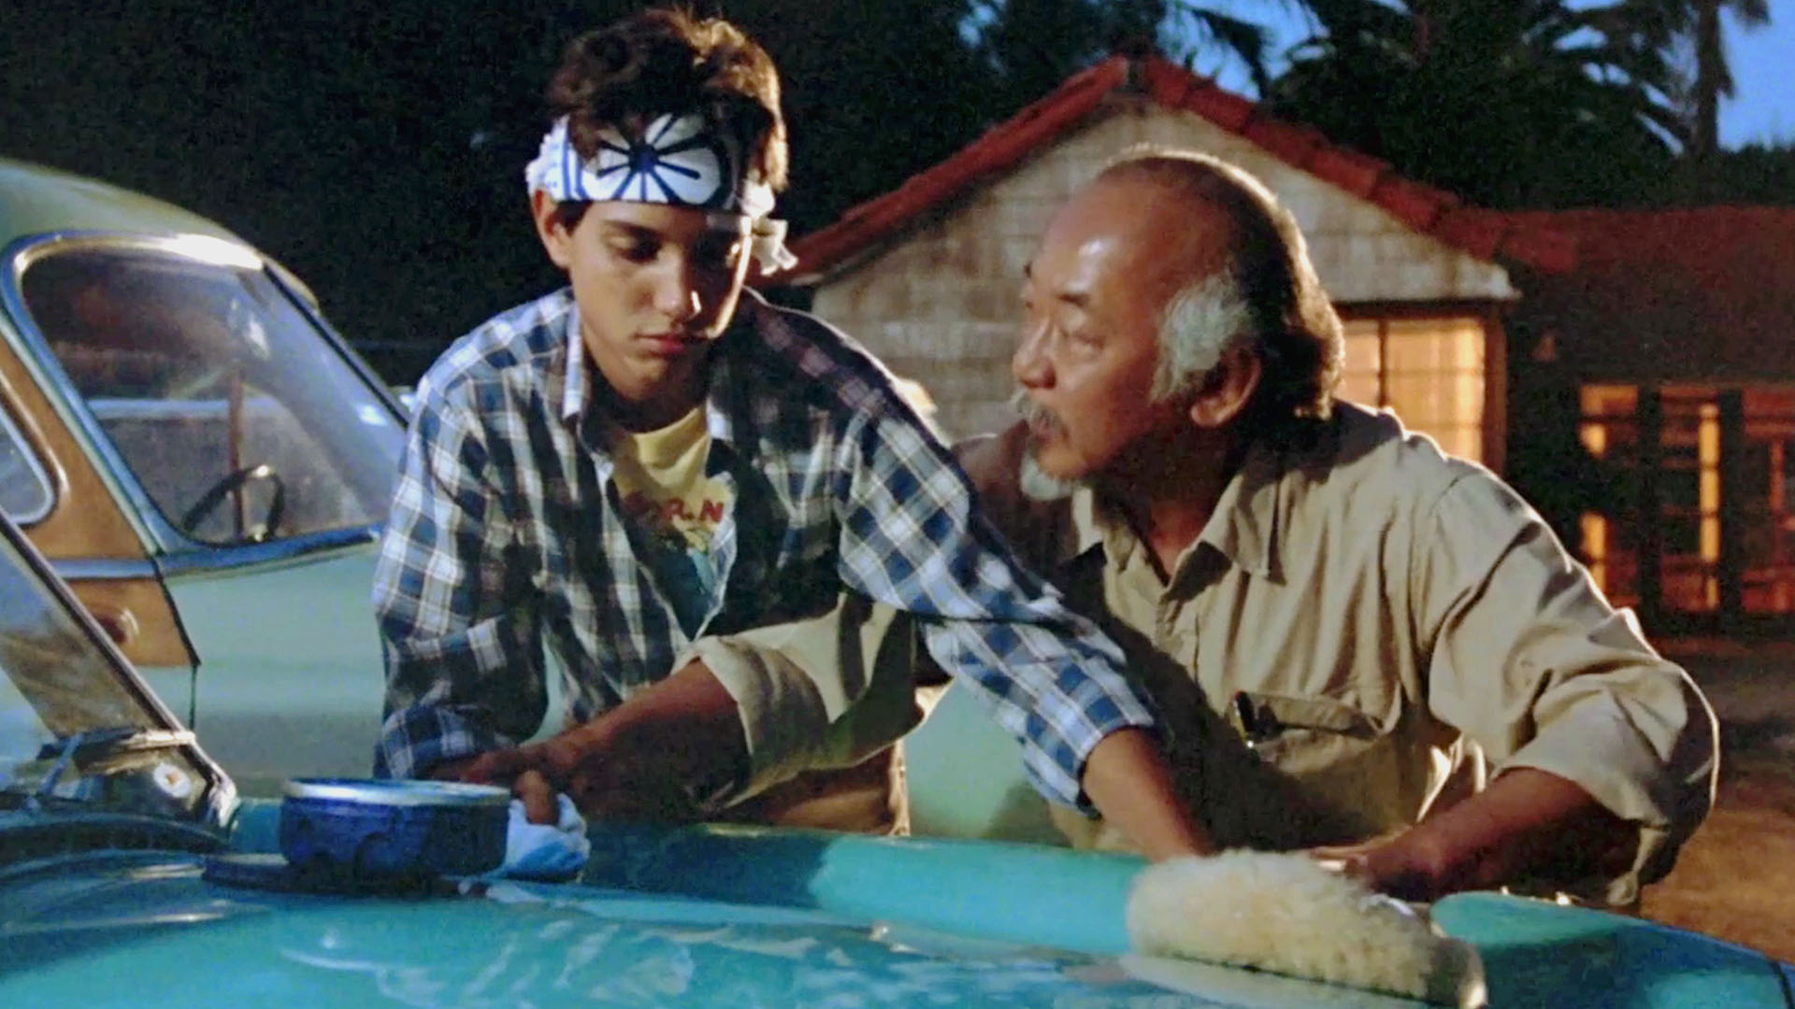


Git Gud with deliberate practice
Notes:
Normal activities is not always an effective way to improve the things that matter
So, what should we do instead? Lets do what athletes, artists, doctors, teachers, chess masters, writers, spelling bee-ers, etc do: practice.
--
Let’s swing back to that side-project suggestion.
Is your Kubernetes Cloud Raspberry PI, VueJS Uber for Ponies app effectively addressing your true goals? And by “effective”, netting you a worthwhile return on time investment? For example, if your goal is to become a better JS dev then that time spent trying messing with Kubernetes isn’t contributing to that goal. That doesn’t mean that time with Kubernetes isn’t valuable, so if you value that experience then maybe you need to realize that your goal isn’t actually to become a better JS dev – it’s bigger than that. No problem there, but it’s important to understand your motivations and goals.
Another thing to consider is how much common ground is there between your projects and your day job? And a more broader question that Scott Hanselman likes to ask “Do you have 10 years experience? Or do you have the same year of experience 10 times?” If your side project isn’t pushing the boundaries of your skills, then what you’re actually doing is hardening your existing skills, learning more about your project domain, or maybe studying some new programming technique, paradigm or framework.
None of these things are bad, but if your true goal is to be a better JS Dev – then your goals and your actions are out of alignment and your are not making an effective use of your time. And, because of your mixed motives and mixed actions, it’s really tough to measure your benefit. Even worse, if you’re just throwing together bare bones MVP projects so that you can spend more time on the “meat” of your experienced, are you codifying bad habits?
So, what should we do instead? Lets do what athletes, artists, doctors, teachers, chess masters, writers, spelling beeers, etc do: practice.

Slide 17
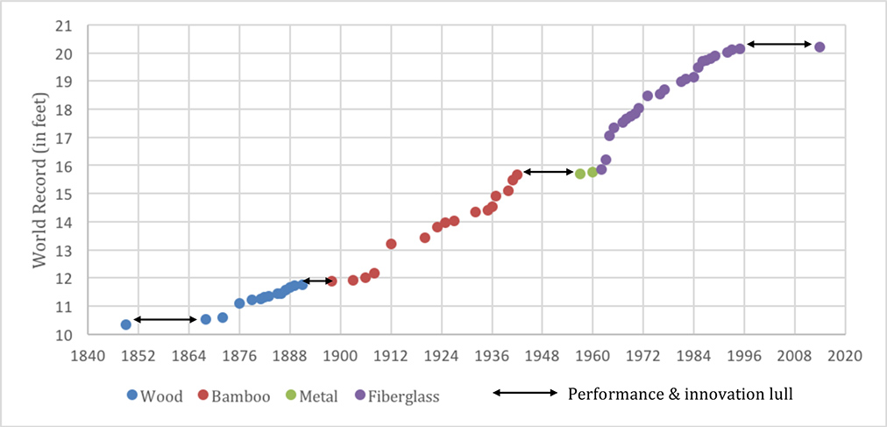
Is it the shoes?
Notes:
The Olympics would be kinda boring if all the records were set back in 1970!
Teenagers routinely perform the concertos that were reserved for the best soloists of the 18th century
There are 11 year old’s on YouTube that can out shred Eddie Van Halen,
That’s because of technology: the shoes gets better, nutrition, the science gets better, paint brushes get better, yadda yadda
Innovators develop new techniques and technologies that allow for leap frogging
So, why do researches think that the way we practice is so important?

Slide 18
Deliberate is...
Intentional
Improving and Appropriate
Responsive
Repetitive
Not fun
http://www.learningspy.co.uk/training/top-gun-teachers/
Notes:
Intentional
Improving and Appropriate
Responsive
Repetitive
Not fun

Slide 19
A weekend of work…

Slide 20
We can do this!
How to practice programming
Notes:
“Good news everybody!”
We can do this, programmers can leverage the research and techniques from deliberate practice for our own nefarious ends.
10s

Slide 21
Practice for programmers
Do X for Y
CodeWars.com
HackerRank
CodeFights.com
Code Golf
Soft Skills
Toastmasters, writing group, peer reviews
Quality
Static Analysis, peer programming, reviews
Coaching
Interviewing.io
Architecture
Notes:
Here are a couple examples of deliberate practice for programmers.
The X for Y categories are the most clear-cut and measurable – the results are easily graphed. These sites generally have a difficulty rating associated with the problems, and there are plenty of them.
If you’re trying to get better at basic coding competency or become more skilled at language X – Set a timer for Y minutes, log how many problems you do. Try it again tomorrow. Once the bottleneck for solving problems becomes your typing speed, move up a level.
Want to get better at appropriately wielding and implementing data structures, choose that tag on CodeWars or that category on Hacker Rank.
Algorithmic performance? Getting more difficult to practice but you can absolutely google for “algorithmic complexity practice” problems.
What about softer skills? Things that are harder to measure? Communication skills, good abstractions, readable/maintainable code?
In those cases, we can take the lessons learned from other fields.
Even though programming is an art and a science – so is Art, and Artists and Art teachers have this stuff figured out pretty well and there’s a lot of material out there about how to cope with practice with things that are hard to quantify. We actually have it really easy compared to some other fields like healthcare and military! ($34k to fly a fighter jet per hour)
It can be tempting to just ignore the soft skills because the X for Y category are so easy to quantitatively measure and programmers have a bad reputation for being lite on soft skills anyway – but, don’t overlook the soft skills, they might be much more important.
If you want to make an effective use of your time and truly improve your skills

Slide 22
How you should practice
0. Identify your goals
1. Map the relevant skills
2. Assess skills independently
3. Identify a high value target
4. Design an exercise
5. Do the exercise
6. GOTO: 2
Identify
Design
Execute
Assess
Notes:
We’re going to go through these steps individually, I just wanted to highlight the loop here. Repetition is key

Slide 23
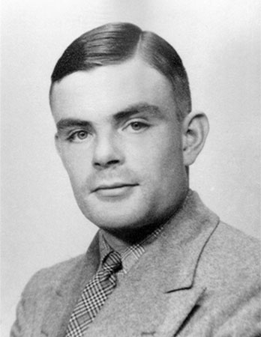
What do you want?
Your definition of “better” is unique
Goals change over time
What do you really want?
Notes:
“Programmer” is a vague term. I’m certain that Grace Hopper’s vision of “better” involves a lot more math than mine. The skills and methods of her practice would be a lot different as a result.
Goals change as well so we need to re-evaluate from time to time. If you asked me what being a better programmer meant 10 years ago I thought Design Patterns were “the peak” of programmer evolution. Right now I’m primarily focused on growing maintainable software systems, modeling business processes, and communication.
Are you more interested in writing the next "GraphQL" or the next "Uber"? That’s two different skillsets.
Either way, it's important that you identify what is important to you.

Slide 24

Map the relevant skills
Coding time
Debugging time
Program size
Performance
Communication
Problem Solving
Abstraction
Attention to detail
Notes:
After we figure out what our goal is, we can break it down into composite skills. I’ve got some examples of skills up on the slide here – including the skills we talked about for the 10x developer.
I also included some soft skills, because unless your goal is to somehow ascend to artificial intelligence-ness - then your goals most likely involve a lot of soft skills.
20s

Slide 25
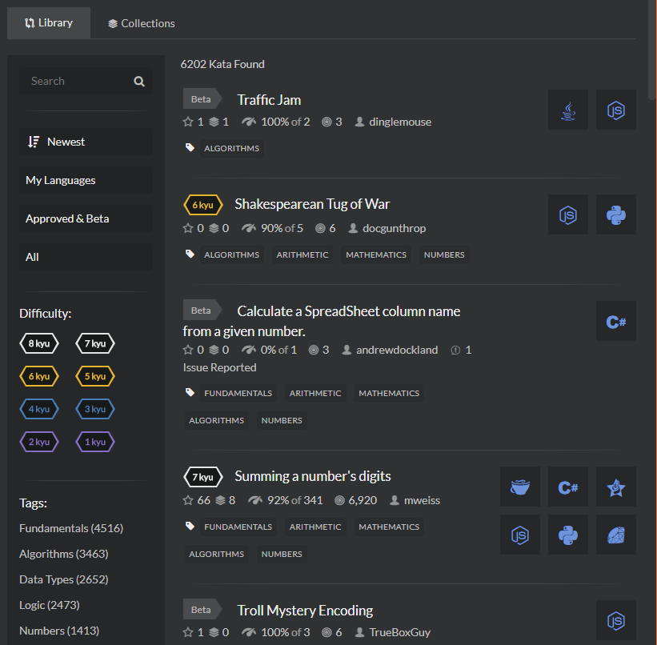
Measure your skills independently
Coding time
Debugging time
Program size
Performance
Communication
Problem Solving
Abstraction
Attention to detail
Notes:
Now that we know what skills we need to improve, it’s time to measure them independently.
Measuring is…difficult. You can take an assessment test, or you can create a baseline from an “X to Y”. Outside of that, we’re looking at coaching, peer review, mentorship, etc
That’s not easy, but it’s never been easier. There are meetups and code camps. We’ve got a great slack group, Orlando Devs too. You’ve already made the first step coming out tonight!
The screenshot here is from CodeWars. I mention this because they also make it easy to see and share solutions with other programmers. We have a great clan, and I think you’ll find that many of the members are eager to share feedback so this is an example of a way to find interested peers. So c’mon in
Worst case scenario, you assess yourself. Give yourself a score, but unlike baselining cut yourself some slack to change that score over time because it’s really easy to under or over rate your self because of things like the Dunning-Kruger effect or other well known problems with bias.

Slide 26
Identify ONE target
Strengthen your weaknesses?
Play to your strengths?
Focus on valuable skills?
Notes:
After you’ve set your goal, broken it down into component skills, then assessed your abilities it’s time to pick a high value skill to go after.
You may decide to work on something your bad at, maybe something you’re good at. Maybe you decide to focus on something that would have additional benefits in other areas of your life.
Any of those is fine, point here is to pick one target

Slide 27
Design an exercise
Understand that effort requires motivation
Take your existing abilities into account
Get quick informative feedback
Repeat, repeat
Notes:
Design time – we want to push on the edges of that ability, with specific timely feedback.
You must be motivated to attend to the task and exert effort to improve your performance.
If it’s easy, or fun then you’re not exerting effort. That’s unfortunate. It’s okay for things to be easy or fun, but it’s not deliberate practice and deliberate practice is the best way to advance skills
Maybe that’s ok for you, it all goes back to what your goals are
2. The design of the task should take into account your pre-existing knowledge so that the task can be correctly understood after a brief period of instruction.
If you don’t understand how to do the exercise properly, then how can you know you’re doing it correctly?
Also, don’t go too hard!
There’s a reason piano teachers don’t start with “Flight of the Bumblebee”. First, it’s discouraging – also, it’s slower, and it’s easier to slip into bad habits. It’s most effective to train at the edges of your abilities. Difficult, but achievable
Imagine a kindergarten teacher saying something to the effect of “Well, I figured if they could read War and Peace, then Dr. Suess would be a breeze!”…but occasionally you will run into people that have that “dive into the deep end” mentality and that may be fine for some activities – but it’s not deliberate practice!
Conversely, it’s a waste of time to practice beneath your skill level.
3. You should receive quick feedback and knowledge of results of your performance.
The quicker the better. It’s common for athletes to closely monitor their heartrate so that they can utilize their energy efficiently. Ideally you would have something immediately stop you as soon as you start to make a mistake.
I do really like how coding tools like Resharper will highlight your indiscretions as you make them. If you pay heed to their advice you’ll codify better behaviors. However, it can also be beneficial to do things like working without IDE if your goal is to improve your performance with a particular language. Yes, you lose immediate feedback by doing this – but if you’re practice intent is to get better at a language then working “blind” might be more beneficial than faster feedback. It would also be much better to try this “blind” exercise after you’re sufficiently proficient with the language otherwise you’re not accounting for your current skill level
4. You should repeatedly perform the same or similar tasks.
If you do it once, then it’s just an assessment. You want to do this over and over to track your progress. Tracking is important because it helps you see when you’ve stagnated so you know it’s time to re-examine.

Slide 28
Advice for Designing exercise
Try to come up with something you can measure
Take lessons from other fields
Code Kata
Increase Difficulty
Time yourself
Record yourself, ask for feedback
Old school flash cards
Train “in the dark”
Debugging
Read code/architectures, describe it in english
Ask your communities
Notes:
Ok, we know what we want to improve at this point. Now it’s time to train on the edge of that ability, with specific timely feedback.
Oft repeated… should not be fun!
Finding a coach, mentor, peer, etc is not “too hard” – it’s never been easier

Slide 29
Do the exercise
Regular, repetitive, disciplined practice is best
Do what you can
Focus, focus, focus
Should see results immediately
Notes:
Regular repetitive logged practice is best.
But, unlike the side project – it can be much easier to pick up where you left off. You don’t have to relearn your skill. But you do need to laser focus on your technique.
Codfiy good habits
If you’ve taken an extended break your scores could very well drop, but that’s okay…it’ll come back quickly
If you’ve heard of Outliers, then you probably also know that the famous “10,000 hour rule” is quite controversial – at least in the “Deliberate Practice” circles. Either way, it doesn’t matter. You should start seeing the benefits of deliberate practice really quickly. You don’t need to put in 10k hours to get better than you are today
Now, go back and assess

Slide 30
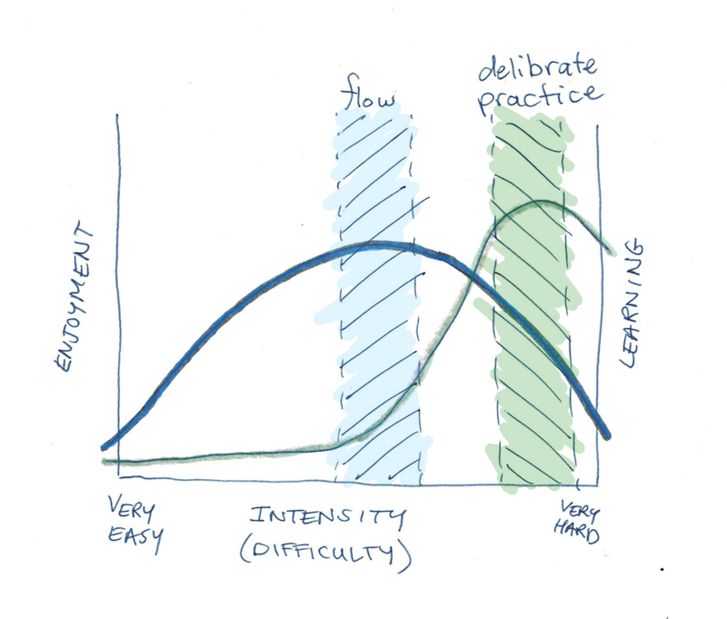
https://www.slideshare.net/rnja8c/competitive-outcomes/24
https://www.scotthyoung.com/blog/2017/03/29/flow-doesnt-lead-to-mastery/
Notes:
Beware of being in the “flow” – that’s another word for auto-pilot, which means you’re not deliberately doing anything. This is associated with stagnation and regression. Remember the guideline, if it’s fun – it ain’t deliberate practice
Now, let’s ask the right question. What’s the difference between deliberate practice and playing around? “Mindless” practice
There have been a lot of studies about this, particularly about how music students and athletes practice. The charts get a bit hairy and specific, but the overall theme is roughly the same and “dedicated practice” is the clear winner: The “better” the practice, the more benefit.
Why bother? Who cares if your side-project is maximally efficient? Doing side-projects gets you experience, it’s good for the resume, and it can be a fun and creative outlet. So, what’s the problem?
The problem is a misalignment of goals. If you want experience, resume points and a creative outlet – then sure, do a side project.
But, if you want to improve your coding skills – then there are better ways. In fact, there have been a lot of studies about the notion of “flow” – which basically encourages you to get into a comfortable state and let your experienced auto-pilot kick in. This can be relaxing, and emotionally rewarding…but can actually make you worse over time. That’s what we see on the graph up there.
There have been a few high profiles studies about this particularly in the medical field. In a nutshell, some doctors hit a skill peak when it comes to certain kinds of diagnoses….and then decline from there. In these cases, statistically speaking, you’re better off getting a doctor with a couple years experience over one who’s grown comfortable. We hear about this sometimes in programming, where the ol’ dog programmer has grown complacent and stuck in their ways – but the new programmers are optimistic and “hungry”
And, crap – I’m an old dog programmer – how do I keep my skills from stagnating?

Slide 31
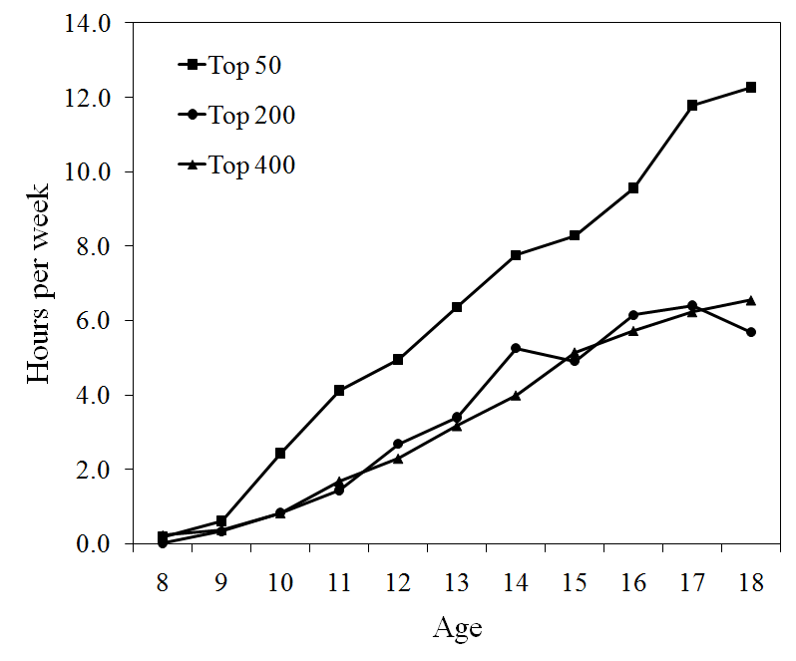
Up and to the right
https://www.experttabletennis.com/deliberate-practice-table-tennis/
Notes:
If you’re able to chart your results, the graph should be heading up and to the right.
If you’re stagnating or headed in the wrong direction, then you might need to adjust the practice routine. There are multiple different ways to practice them same skills, so don’t be afraid to shake things up.
We’re assuming this component skills are making us better over all – and the research backs this up, but why not ask your peers?

Slide 32
how do we solve problems that are difficult To measure?
Coaches
Teachers
Mentors
Peers
Notes:
But do you test your pragmatic decision making?
How do you test your Design Pattern ability?
Well, how do they do it in other fields? Teachers, Coaches, Mentors, Peers
If you’ve read PeopleWare, you’ll know that the biggest problems aren’t always technical!
There are sites that will help you with this
Remember – deliberate practice should be very specific. Don’t send me your repository link and ask me what I think.
Send me your link, and ask me what I thought about your variable names, or abstractions, use of design patterns.

Slide 33
Where are all the code coaches?
Senior Programmers are expensive
Companies are better suited towards mentoring
Notes:
Senior Developers average $80k a year!
18 million developers world wide

Slide 34
How do writers do it?
Examples of goals:
Story-Telling
Write shorter and more persuasive emails
Eliminate weak phrases
Structure content for a more logical flow
How to evaluate?
Coaching
Self Evaluation
https://www.enchantingmarketing.com/how-to-practice-writing-skills/
Notes:
What about musicians?
Practice with the metronome, record
Recitals, objective judges

Slide 35
How to mentor
Better practice
Modeling
Fast and Quality Feedback
Build a Culture of Practice
Utilize the skills
Notes:
Book has a lot of practical tips – a lot of the research was done about teachers.

Slide 36
Mentoring: Preparation
Identify your training goals
Make a plan
Encode success
Normalize error
Come up with a name
Notes:
Come up with a name:
”Modular Design” training
Single Responsibility raining
Remember the specificity naming training – your ”timeout” variable isn’t as good as it could be

Slide 37
Mentoring: During practice
Call your shots
“Get a whistle”, correct immediately
Correct, don’t criticize
Don’t teach during the game, practice
Save the discussions till after the exercises

Slide 38
Mentoring: Post Practice
Measure success
Now discuss the exercise
Utilize the skills

Slide 39
How to be a better interviewee?
White-boarding
Coding under pressure
Solving puzzle problems
Language/Framework
“What’s your greatest weakness?”
Take Home Projects
Dressing appropriately
Active listening
Computer Science-y things
(Check out https://interviewing.io/)
Notes:
One last thing to throw in here, I thought it might be interesting to do a quick take on interviewing.
What kind of skills might you need to improve if you want to be a better interviewee?
I’ve listed a bunch of ones that I came up with, and hopefully you’re already thinking of ways to test each one.
Yeah…you can “just go interview” – but that 1 hour of practice costs you getting ready, taking time off of work, setup time, etc.
I think communication and dressing appropriately are the hardest skills up there, and also the hardest the objectively measure – so I recommend asking a trusted friend or community for help there. The rest are surprisingly easy to quantify. There are great resources on the internet

Slide 40
SUMMARY
Skills are important and neglected
Deliberate Practice is the most effective way to advance skills
We can do this!
https://www.codingblocks.net/practice/
Notes:
So, that’s it!
Getting better means improving your knowledge and skill, and skills are often sadly neglected and trickier to work on.
The good news is that there has been a lot of research done on the best way to advance skills.
I hope that you’re now feeling invigorated and inspired to try deliberate practice for programming.
And, of course – I would love any constructive criticism you have for me. I’m trying to practice my communication skills this year, and I really would love the feedback!

Slide 41

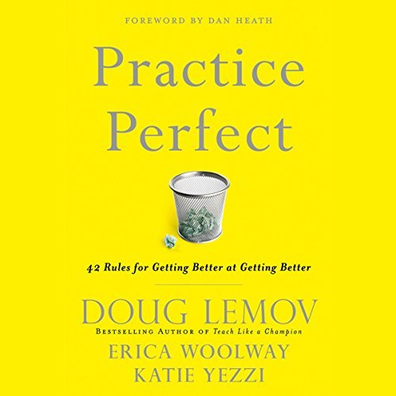
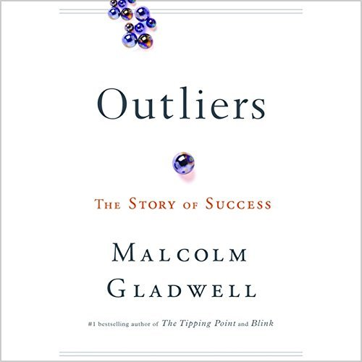
Audiobooks!
Notes:
Here are a couple of the more popular books on the subject. I’m a big fan of audiobooks myself

Slide 42
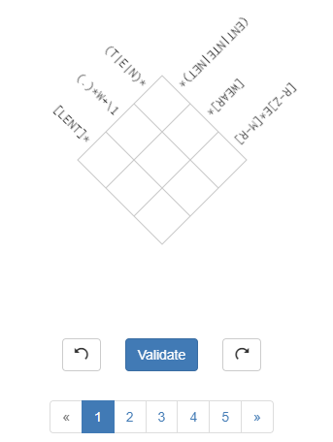
X for y Sites
Code Wars
Project Euler
Hacker Rank
Regex Crossword
The GIT Game
UVA Online Judge
{Your next side project here?}
Notes:
List of websites

Slide 43
codingblocks.net/practice
Slides available
Articles and Essays
Other resources and sources

Slide 44
Mostly a Podcast
Joe Zack
joe@codingblocks.net
@codingblocks
Notes:
Thank you very much!

